Slide 1
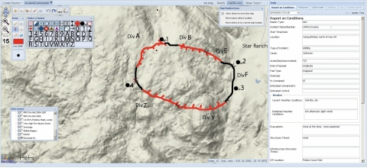
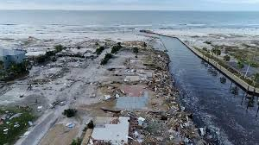
Automatic Disaster Image Annotations
Connor Grimberg & Joseph Lee
Under our Directors Mr. White & Dr. Gabor

Slide 2
Overview (I may choose not to include this slide in the final product. To be determined.)
Background
Alarming stats.
Introducing Civil Air Patrol
Problem/motivation
Proposal → A.I. solution
Convolutional Neural Networks (CNN)
Web application
Retrain feature

Slide 3
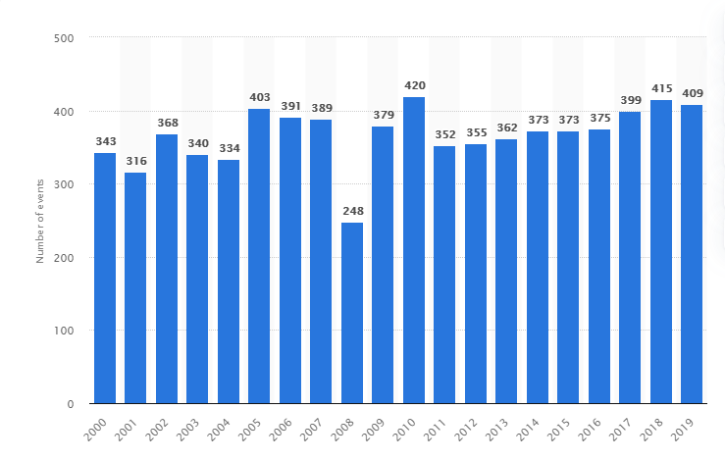
Alarming Stats for Past 20 Years
1,300,000 died
4,400,000,000 impacted
~60,000 die/year
Annual Number of Natural Disaster Events Globally from 2000 to 2019
Notes:
Impacted = injured, homeless, displaced or in need of emergency assistance
https://www.unisdr.org/files/61119_credeconomiclosses.pdf
this source also applies to the "Killed 1,300,000" statistic too.
Graph source: https://www.statista.com/statistics/510959/number-of-natural-disasters-events-globally/

Slide 4
Well, what is being done to prevent deaths?

Slide 5

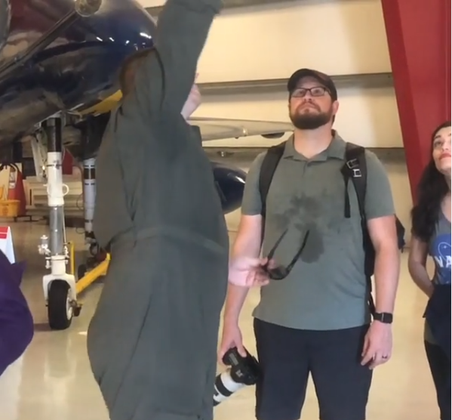
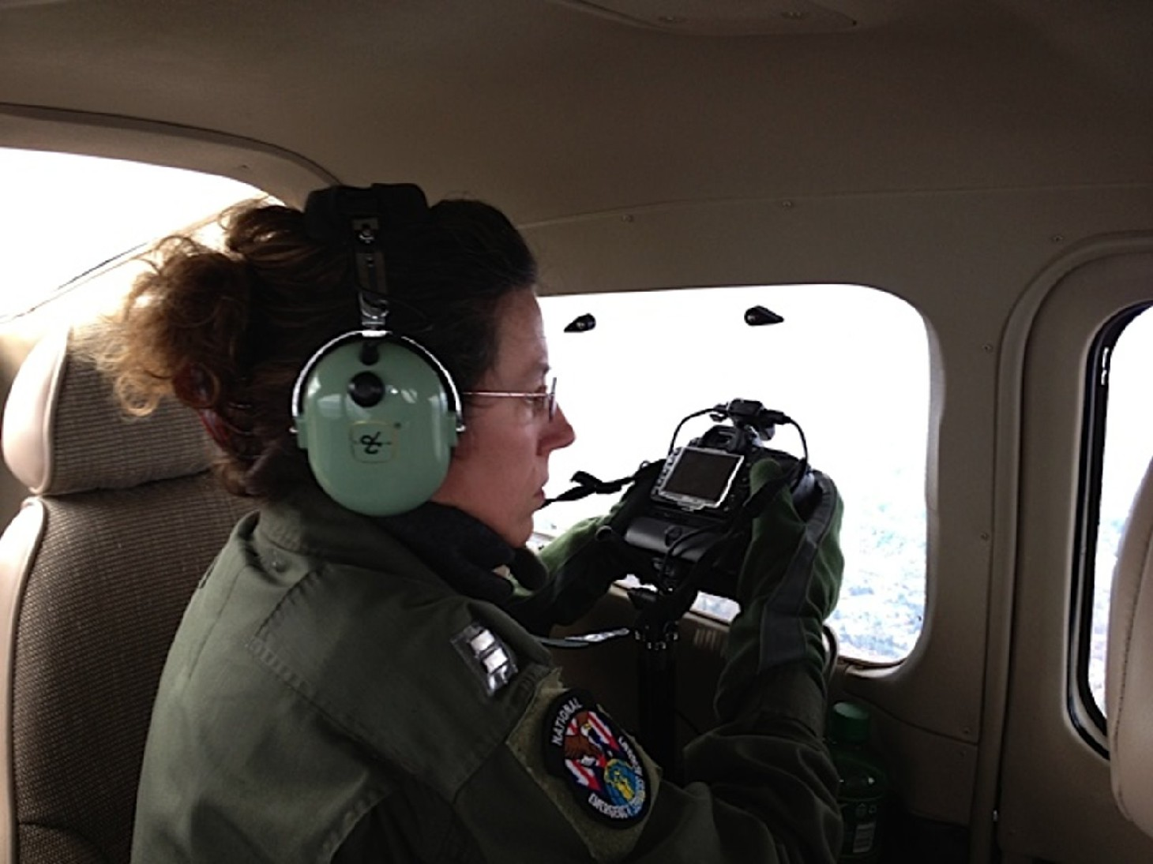
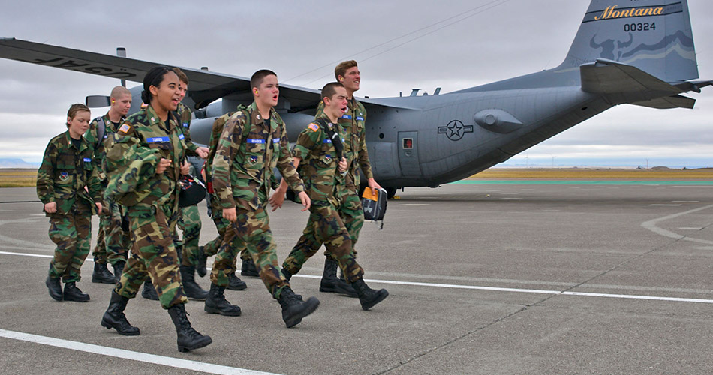
Introducing Civil Air Patrol (CAP)
Originally national defense service
U.S. Air Force Supplement
Emergency service missions
E.g. aerial photos of disaster area
Used for: disaster assessment and/or search & rescue

Slide 6
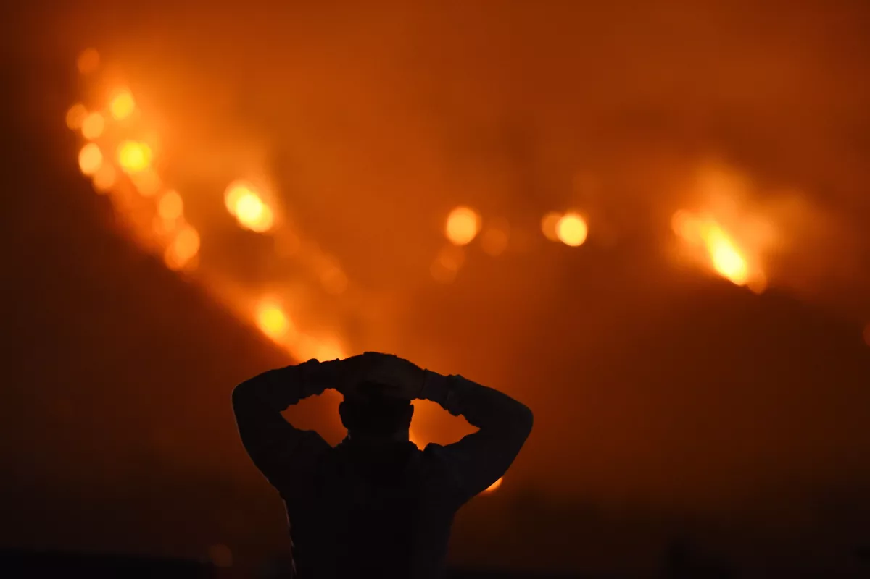

The Problem/Motivation from CAP
Time issue
Lives on the line
Reduce time with automation
Notes:
https://communities.geoplatform.gov/disasters/civil-air-patrol-cap-browser/
The Civil Air Patrol (CAP) is a nonprofit corporation that assists people in need of help especially after a disaster, most commonly a hurricane. CAP provides numerous aerial imagery of inundated areas, failed dams and things relating to natural disasters. Analysis of the imagery aids FEMA in the decisions process leading to more effective, survivor centric, response. Currently, the workers at CAP upload and annotate thousands of images by hand.
State of the art: CAP
Next-Generation ICS

Slide 7
Formal Proposal
Using the power of accessible artificial intelligence and accessible web application development, I aim to speed up disaster response for first-team responders.
Notes:
Original Try:
I am creating an Artificially Intelligent website application on behalf of the Civil Air Patrol and related disaster team responders to significantly speed up the disaster response process.
Try #2:
Using the power of accessible Artificial Intelligence by fast.ai and accessible web application development by Streamlit, I aim to speed up the disaster response for first-team responders.

Slide 8

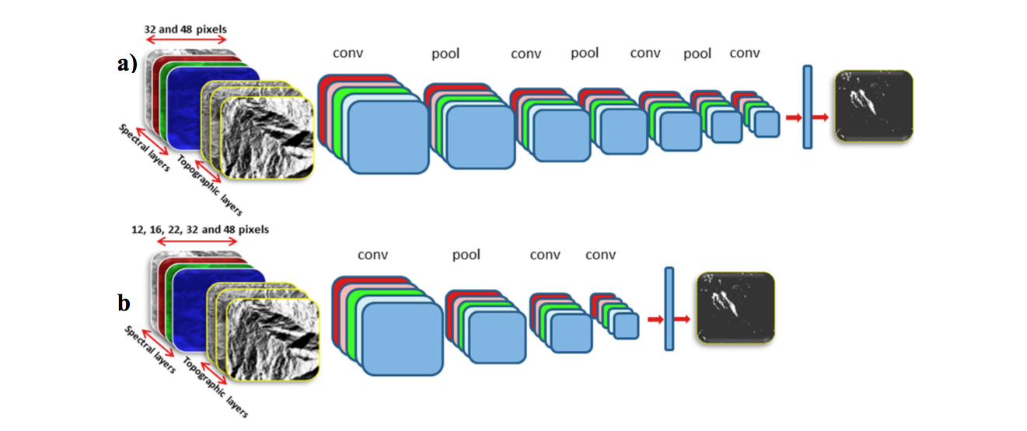
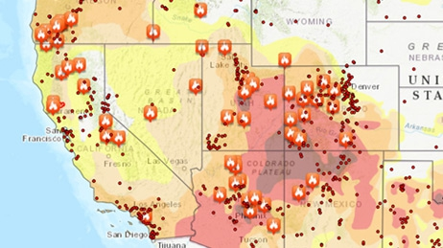
Our Solution
Easy-to-use web application
Input: image folder
Output: Autonomous annotations
Convolutional Neural Networks (CNN)
Severity rating → map → rescue teams
Notes:
We want to create a program that can take many images and autonomously annotate them, so workers at CAP won’t have to. We would also like to include several features such as, severity rating of each picture/location, and an easy-to-use website that helps navigate the large amount of images CAP takes.
Disaster map?

Slide 9
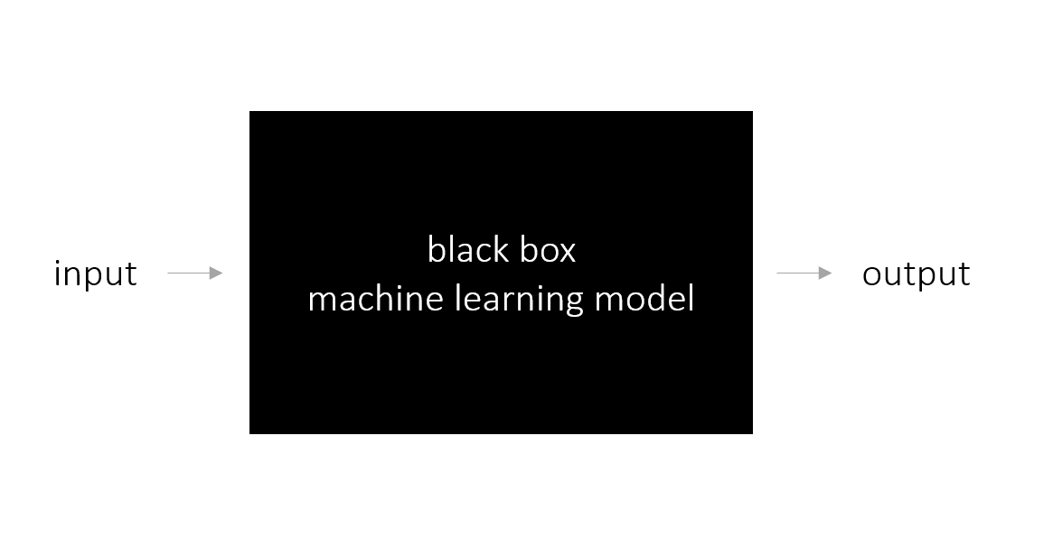

What is a CNN? (Part 1)
Error

Slide 10

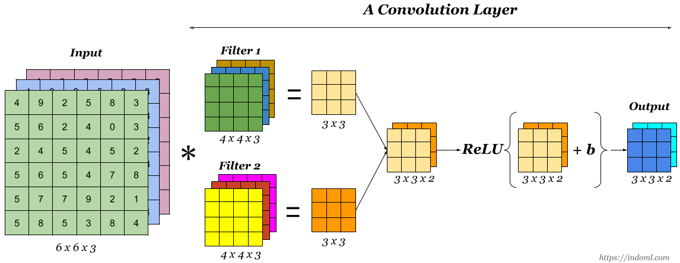
What is a CNN? (Part 2)

Slide 11
CNN: The Full Picture

Slide 12
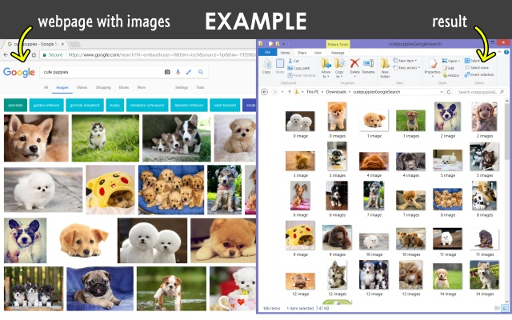



Single-label CNN
Purpose:
classify disaster type
prep. for multi-label CNN
Means:
Google Images
“Download All Images” Chrome extension
1000 images per disaster
Earthquake, fire, flooding, hurricane, and normal
Fast.ai (accessible AI)
Google Colaboratory + Google Drive

Slide 13
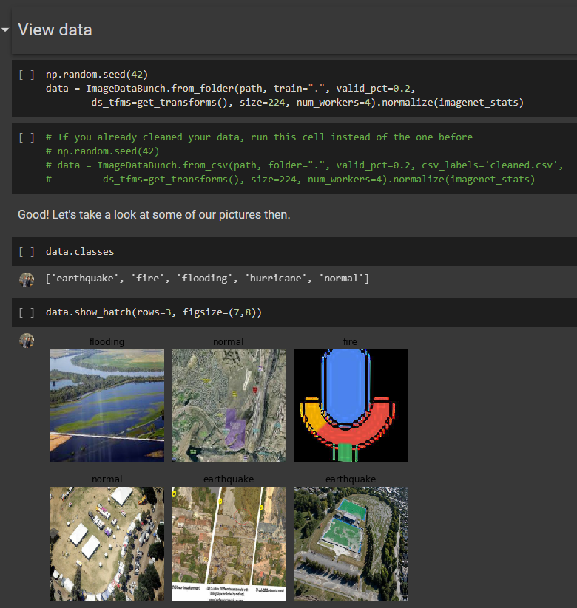
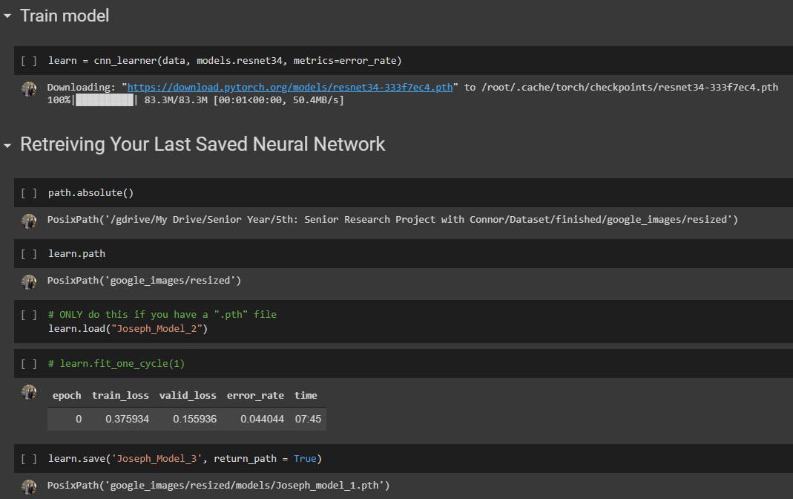

Slide 14
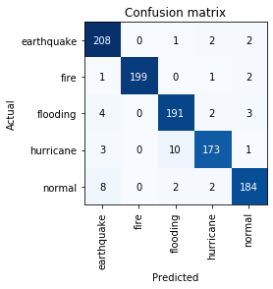
Single-label CNN Results
4.40% error

Slide 15
Multi-label CNN
Purpose:
classify disaster type(s) + details (next slide)
Means:
Google Images
Dataset: 500 images
100 per disaster
Reasoning: manual annotation time
Relied on retrain feature [I have not implemented this yet, but hopefully I will in the near future.]
fast.ai (accessible AI)

Slide 16
Multi-label Details
Structural damage
Road
Low vegetation
High vegetation
River
Rough Terrain

Slide 17
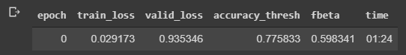
Multi-label CNN Results
Results after training:

Slide 18

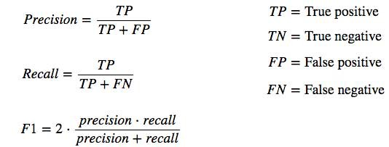
Fbeta Score Explanation

Slide 19
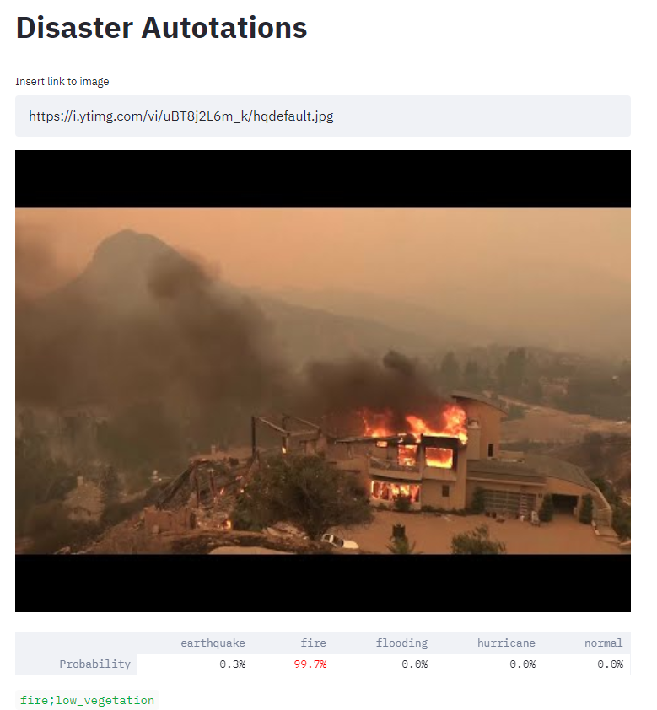
Web App
Purpose:
User interaction (CAP/normal)
Retrain (user input)
Means:
Director (accessible web app dev.)
Input: a link
Output: annotations
[I will include an upload feature on my web app.
since that is now available on Streamlit. Thus, I will have a
newer screenshot in the final presentation.]

Slide 20

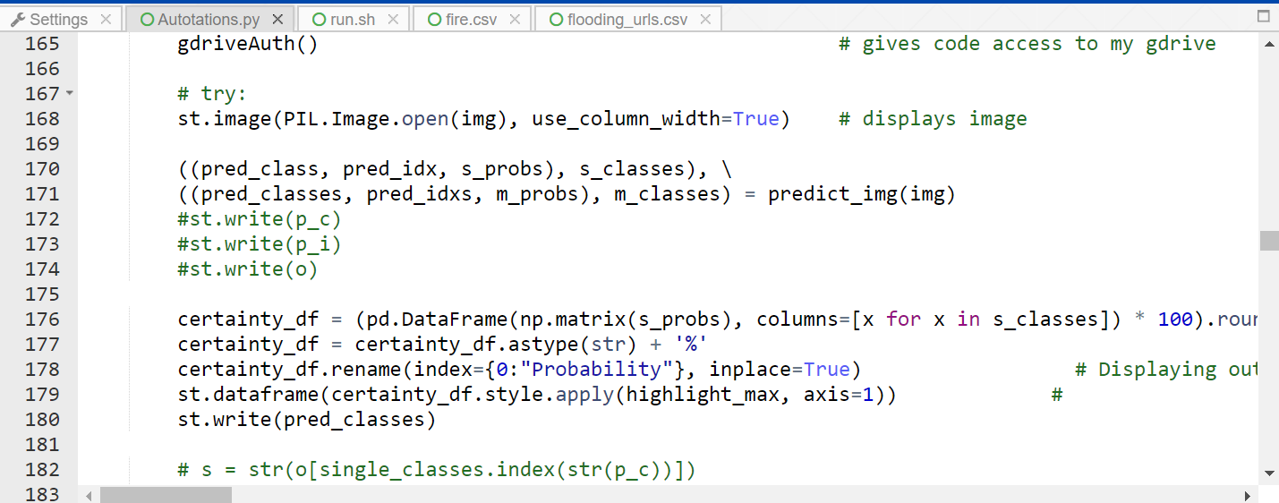

Slide 21
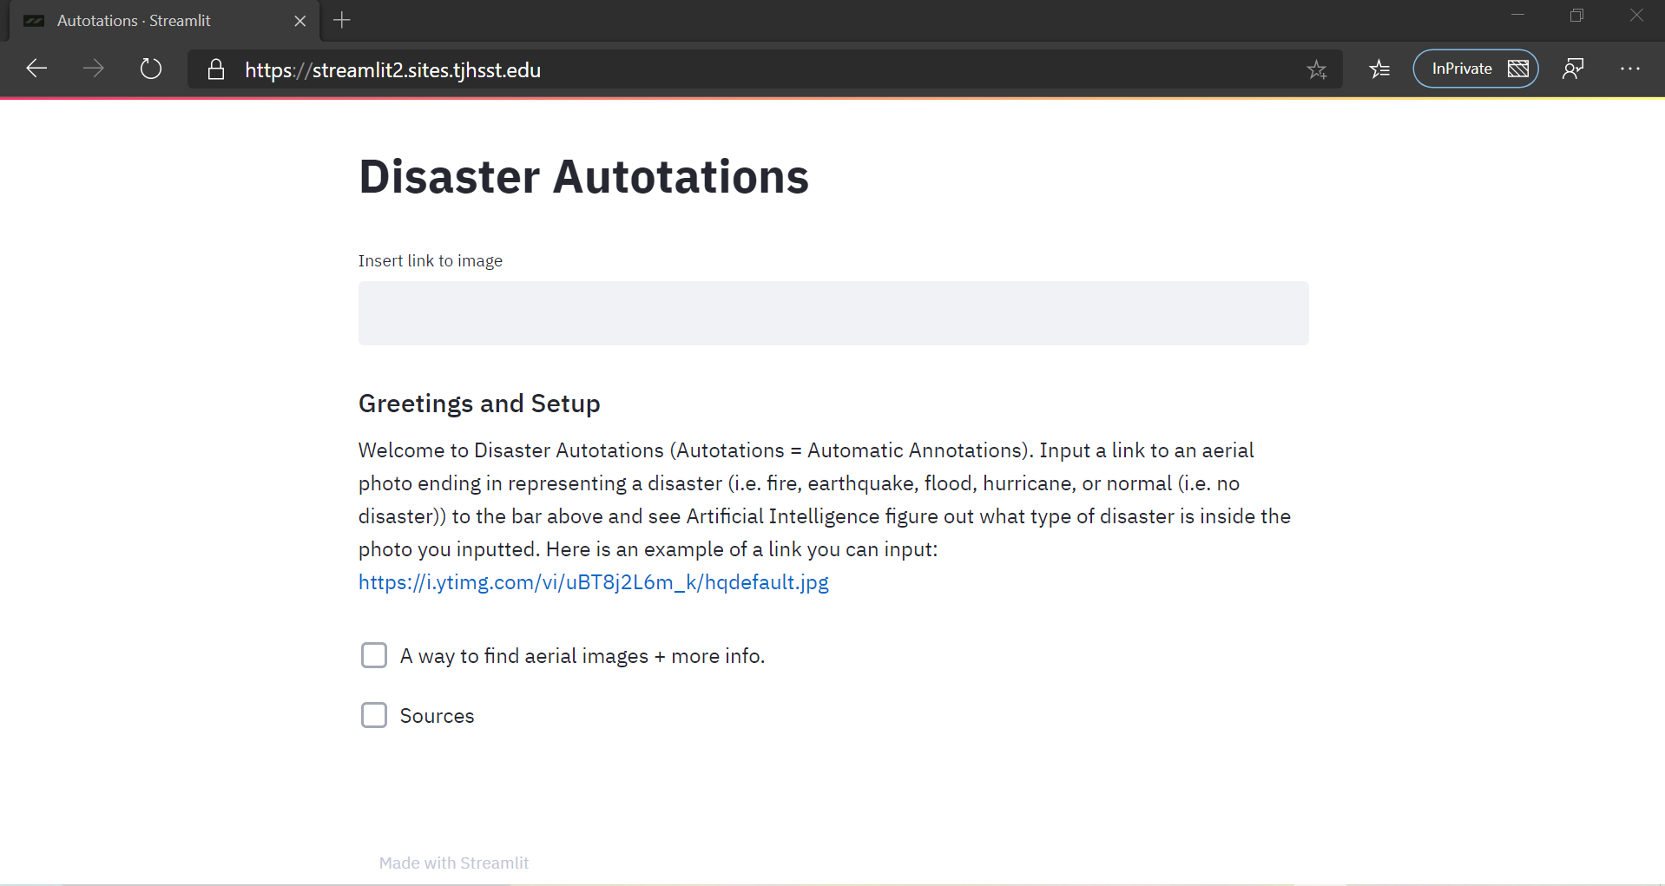

Slide 22
Retrain
Purpose:
Refine accuracy of NN
Adapt to new looks
Method:
Send user generated labels and images to a server (currently my computer)
Daily retrain of the NN
Preserve the highest accuracy version
Flaws:
Relies on user accuracy
Long-term changes
Currently unreliable implementation

Slide 23
(Retrain code slide; Depending on the size of the code, I may screenshot the whole code or a representative sample.)

Slide 24
For Prospective Students
Future of this project?
JOIN the effort!
Potential avenues:
Severity rating
Efficient escape routes
Optimal datasets (to inc. fbeta)
[I may insert more avenues in final presentation]

Slide 25
Credits
Directors Mr. White and Dr. Gabor
Research partner Connor Grimberg
Remote Sensing for Disaster Response course
Other TJ peers involved
[I may come up with more people to thank later.]

